Slide 1


10 Ways to Improve Cybersecurity Insurability & Minimize Rates

Slide 2
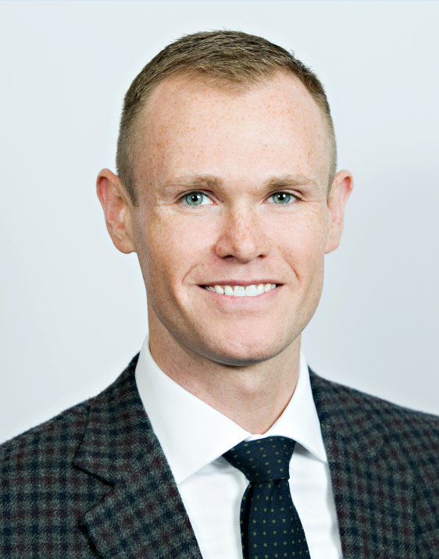
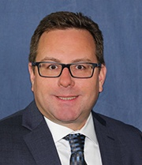

Presenters
David Wasson
Vice President, Cyber Practice Leader
RPLU | CIPP/US | CIPM | FIP | CCIC
Hays Companies
Randy Anderson
Manager, Cybersecurity and IT Consulting
CISSP
Loffler Companies

Slide 3
Agenda
The Cyber Risk Landscape
Risk Management
Paying Ransoms

Slide 4
The Cyber Insurance Landscape
Increasing Losses – Rate Increases
Capacity Limitations
Coverage Limitations
Increased Underwriting Standards

Slide 5
The Cyber Risk Landscape
The Cyber Timeline
Ransomware
Business Email Compromise
Systemic Risk

Slide 6
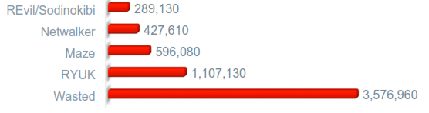
Average Ransom Paid By Type

Slide 7
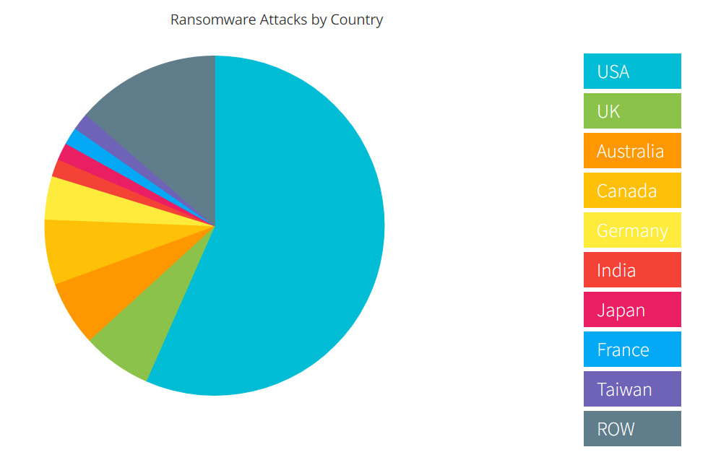
The Cyber Risk Landscape

Slide 8
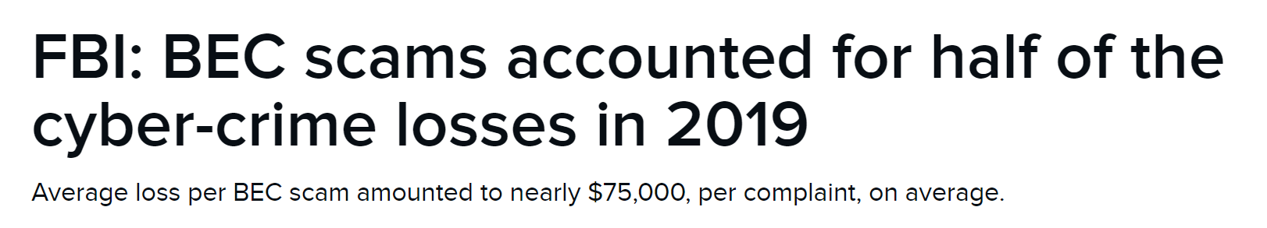
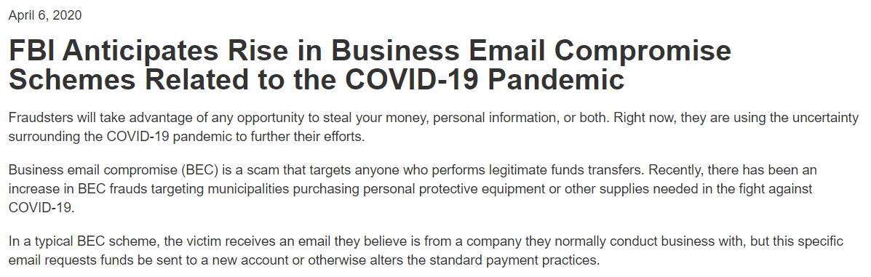
The Cyber Risk Landscape

Slide 9
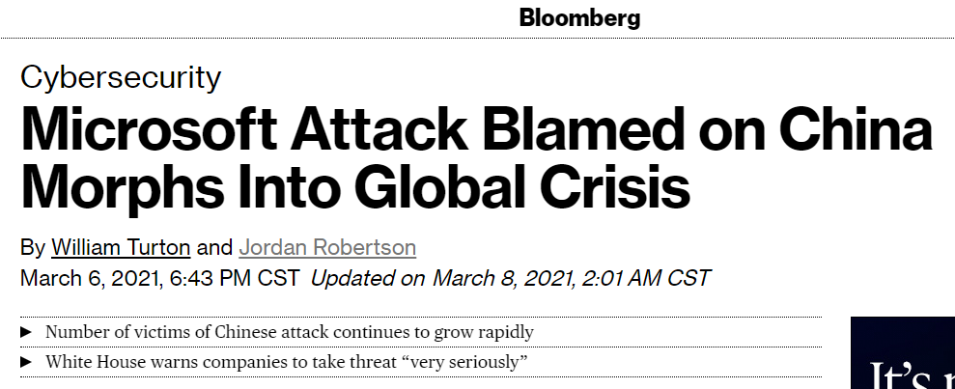
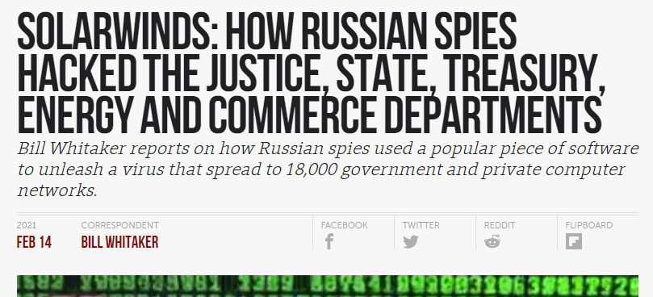

The Cyber Risk Landscape

Slide 10
10 Ways to Improve Cybersecurity
Assess Your Information Security
Implement Out of Band Authentication
Create a Set of Information Security Policies
Create and Practice an Incident Response Plan
Review Recovery Time Objectives
Disable RDP Access
Enable Multi-Factor Authentication
Implement Effective Logging
Perform Vulnerability Scanning
Implement Endpoint Detection and Response Tools

Slide 11
Assess your Information Security
Vulnerability Scan
Penetration Testing
Free/included assessments with M365 and Azure
Business Impact Analysis
Asset-based risk assessment
Scenario-based risk assessment
Begin with a formal Assessment
  Administrative controls (people, policies and processes)
  Physical controls (cameras, locks, lighting...)
  Internal technical controls (servers, workstations, wireless…)
  External technical controls (firewall, DNS, social media, file sharing sites…)

Slide 12
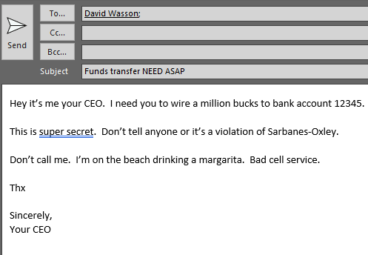
Implement Out of Band Authentications
Social Engineering Fraud (SEF) losses estimated at $1.9B in 2019
Out of band authentications most effective in stopping SEF
Additional considerations:
  Dual authorizations
  Phishing simulation tools
  SPF
  DMARC
  DKIM

Slide 13
Create a set of information security policies
Policies guide the organization
Procedures and plans are more specific
Be aware of the shared risk model of cloud computing
  Who is responsible for data backup, how long are backups retained
  Azure PaaS – Microsoft managed the infrastructure, someone else manages the OS
  What are the SLAs
Consider compliance requirements
Consider insurance underwriting standards
Most organizations will end up with 15-25 separate policies

Slide 14
Create and practice an incident response plan
Inter-related with the overall Business Continuity plan
Include key contacts
Write it
Practice it – tabletop exercises
Improve it – lessons learned
Review it at least annually
If encrypting malware hits, can you get to your IR plan?

Slide 15
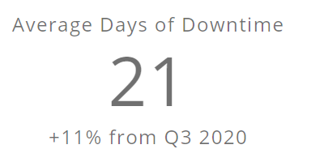
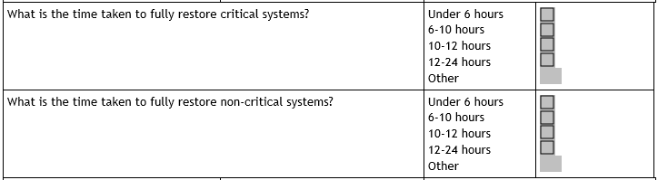
Review Recovery Time Objectives
What is an RTO?
Are RTOs realistic?
How to plan for exceeded RTOs

Slide 16
Disable RDP access
Open RDP (a.k.a. Windows Terminal Services, Remote Desktop Services) is a major attack vector
  Even if you change the port…
  Even if you don’t have a DNS name associated with it…
  Even if you’ve patched…
  Even if you have good passwords…
  Even if you don’t think you’re a target
Must be secured behind a VPN to be safe

Slide 17
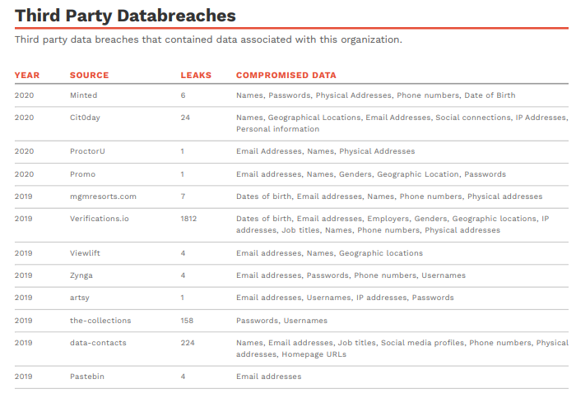
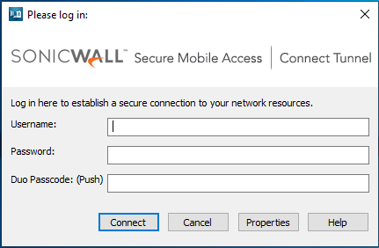
Enable Multi-Factor Authentication
What is it?
When is it needed?
What’s the impact?

Slide 18
Implement effective logging
Implement effective and appropriate logging, log file aggregation and alerting
Make sure that all systems are synchronized for time
Make sure that logs are kept for at least 90 days
Who is watching the logs? – A human or a computer?
SIEM - Security Information and Event Management
  Allows machine learning algorithms to watch the logs
  Allows for event correlation

Slide 19
Perform Vulnerability Scanning
This is important for checks and balances
May be required for compliance
Uses a tool that detects and enumerates devices on the network
Identifies the device
Probes for vulnerabilities
Summary report of CVEs – Critical, high, medium and low

Slide 20
Implement Endpoint Detection and Response Tools
Used in addition to antivirus tools
Varying levels of products available
More expensive than other options

Slide 21
Paying Ransomware – Discussion

