Slide 1

Maintaining a Superior
Customer Experience
in the Hybrid Work Environment

Slide 2



Interact with this Webinar
Tell us how you’re feeling during the webinar… happy, sad, laughter, applause – all
right here
Send in your questions using
the Q&A feature
Click here to switch between phone and computer audio options.

Slide 3
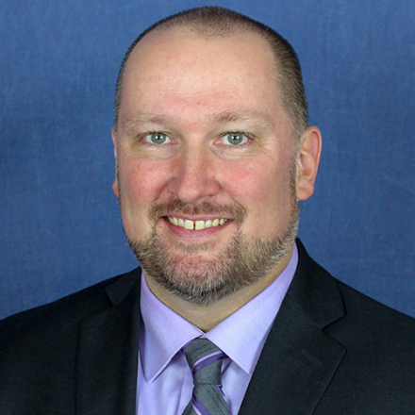


Today’s Speakers
TERRY LAPOINTE
ANDREW BOONE
EOIN BATHE
Manager,
Unified Communications
Loffler Companies
Senior Mgr., Sales
Intermedia
Sr. CCaaS Sales Specialist Manager

Slide 4













Helping Customers & Companies Connect
Management Applications
Workforce Management | Reporting
Quality Management | Supervisor
Email
In-House Agents
INBOUND
Customer Service
AGENT
Phone
CUSTOMER
Outsourced
Agents
Web
Work-at-Home
Agents
OUTBOUND
Sales & Marketing
Social Media
Experts
Chat
Integrations
CRM & Other Business Applications
Mobile
Self-Service
Notes:
UPDATE LOGO HERE!

Slide 5


What every business must solve for
Communicate and collaborate with each other
Work with
with customers
Notes:
Let’s keep it simple:
Regardless of the type of business or, what’s happening in the world, businesses must enable communication 2 types of communications
Collaboration between your employees
Connection between your business and your customers

Slide 6

Unified Communication (UCAAS) &
Contact Center (CCAAS)
Provides organizations with the flexibility for their staff to work:
  IN THE OFFICE
  FROM HOME
  OR ANY LOCATION…
  …and to do so without changes to the communications infrastructure,
  cost structure, or behaviors.

Slide 7
CCaaS: What, and Why?
CCaaS (Contact Center as a Service)
Contact Centers, in a nutshell, allow companies to interact with customers, and vice versa, through multiple communications channels. The objective of a good Contact Center is to facilitate exceptional customer experiences, via a series of human interactions, made possible by intelligent software, and best-practice processes.
A great Contact Center – which was once seen as a cost or expense - is a hugely valuable strategic asset in today’s service-driven economy.
Functions can include: sales; support; technical assistance; customer feedback; patient care; scheduling; constituent inquiries (in the case of governments), and much more.
CONFIDENTIAL
Notes:
You need to elevaoe your coneversation beyond the IT folks.
Here is what is happening and who is buying ti

Slide 8

Change can mean superior outcomes
Multiple studies demonstrate that remote workers:
Have
Are
Willingly work
27%
13%
16
Less daily idle time than in-office counterparts
More days per calendar year
(cumulative total over year)
More likely to stay with the company long-term
SOURCE: https://www.inc.com/marcel-schwantes/new-study-reveals-why-working-from-home-makes-workers-more-productive.html

Slide 9
Poll Time!
What challenges do you see in customer experience?
(Poll will appear on-screen)
Notes:
-Getting callers to the right people (IVR, routing)
-Knowing how well we’re serving customers (monitoring and dashboards)
-Being able to review interactions in depth and correct issues (recordings, reporting)
-Outreach to customers – they don’t always call in (outbound capability, Dynotes, power dialing)
-Scheduling and managing our own people (WFM)

Slide 10
What every business must solve for
Communicate and collaborate with each other
Work with
with customers
Notes:
Let’s keep it simple:
Regardless of the type of business or, what’s happening in the world, businesses must enable communication 2 types of communications
Collaboration between your employees
Connection between your business and your customers

Slide 11

The Phone is now the Front Door
Think about this…
In Spring 2020, business models shifted from “business as usual” to “everything happening over the phone.”
How can your customers ensure they’re able to meet demand, now, and in the future
How do they know they’re delivering a great experience “over the phone”
Many companies are moving to UCaaS solutions to
de-centralize their workforce via their phone system(s)
Those companies are also leveraging CCaaS solutions to centralize their ability to handle customer interactions

Slide 12
The Phone is Now the Front Door
Why is this? What is driving this accelerated move
to Cloud Contact Center?
External events unforeseen developments can alter business reality overnight
Future-proofing acquiring the flexibility needed for true business continuity
Multi-Channel needs due to increased interactions via phone/SMS/email/chat/social
Insights needed many contact center systems, especially on-premise ones, are unable to deliver the data required to derive valuable insights

Slide 13

Who Needs a CCaaS/Superior Customer Experience?
Everyone!

Slide 14
Businesses of ALL sizes and types can benefit
Think again!
Do you have customers calling you? Do you need to contact them? Then you need Contact Center.
How are you managing those inbound calls? Yourself?
Someone else?
Do you have any customer complaints?
How are your online / google reviews?
Are you able to run real-time reports on your customer interactions?
What would you use that data for?
What tools do you have to rapidly improve customer satisfaction,
and do they offer easy integration and reporting?

Slide 15

All Service-Based Verticals
Any company that interacts with its customers, needs a solution to manage those interactions.
Billing and Inquiries (IVR, routing, payment IVR)
Customer Service and Support (multi-channel support)
Technical Support and Helpdesk (skills-based routing)
Automating Appointments and Scheduling (Dynotes)
Customer Outreach (SMS channel, power dialer)
Self-Serve customer service (Interactive Voice Response)
Live Chat Support (web chat, ICR)
Notes:
We are going to tell you that there is great opportunity not ready overnight but we are here to support you
Go out with the conf we got your back!!

Slide 16
Poll Time!
Any changes in customer
trends in the last year?
(Poll will appear on-screen)
Notes:
-Notable uptick in demand
-Notable downturn in demand
-Steady business, but conducted through new channels
-Needed to make significant business pivots
-No major change so far

Slide 17

Let’s back this up with numbers…
60%
of failed attempts at First Call Resolution (FCR)
could have been prevented, with a Contact Center solution that rapidly gets the agent to the right data
CONFIDENTIAL
https://logmeincdn.azureedge.net/jivemedia/library/wp-content/uploads/2017/08/CCenterEbook.pdf

Slide 18

Let’s Back This Up With Numbers…
Let’s back this up with numbers…
66%
of customer loyalty decisions
are driven by customer experience
Contact Center helps drive loyalty with quicker resolutions,
less customer effort, and continual team improvement.
SOURCE: https://emtemp.gcom.cloud/ngw/globalassets/en/marketing/documents/creating-a-high-impact-customer-experience-strategy-gartner-for-marketers-11-22-2019.pdf

Slide 19


Let’s Back This Up With Numbers…
Let’s back this up with numbers…
of customers stopped doing business with a company after a bad experience
73%
consumers point to customer
experience as the key factor
in a purchasing decision
82%

Slide 20
Let’s Look at Some Verticals….
Finance
Education
Healthcare
Service

Slide 21



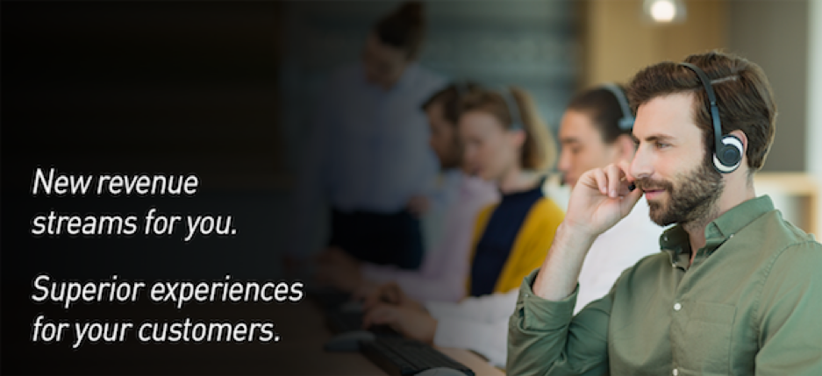
Businesses Large and Small
Productivity and efficiency in customer care processes
Flexibility on customer service times
Ways to contact and connect with customers
Fast response to manage wait times for customers
Managing outbound call strategy for sales
Ability to reach to your mobile customers
NEED:
….to provide exceptional customer experiences
Notes:
We are going to tell you that there is great opportunity not ready overnight but we are here to support you
Go out with the conf we got your back!!

Slide 22


Benefits of CCaaS in Financial Vertical
Finance needs:
Scalability
Cost certainty
Easy plan and forecast
Differentiation via client service
Solution can help:
Plan for spikes in demand
Add or remove seats as busy seasons (e.g. tax time) come and go
Gain insight into customer journey and friction points
To deliver:
A consistent CC experience with excellent responsiveness
Cost certainty along with the flexibility to scale as needed
Ease of doing business and a personalized client experience
Notes:
We are going to tell you that there is great opportunity not ready overnight but we are here to support you
Go out with the conf we got your back!!

Slide 23

Benefits of CCaaS in Education
Education needs:
Rapid and seasonal scalability
Differentiate calls from students, alumni, staff, etc.
Route student calls to the right department
Proactive outreach to students, via
Solution can help:
Scale for major fluctuations
Automatically look up records based on caller ID
Apply routing rules to speed connections and reduce error
Deliver a multi-channel outreach suite
To deliver:
CC teams equipped to handle peak times (e.g. enrollment)
Callers connected to the right agents, with call context
Students and staff kept up to date on planned and unplanned changes
Notes:
We are going to tell you that there is great opportunity not ready overnight but we are here to support you
Go out with the conf we got your back!!

Slide 24
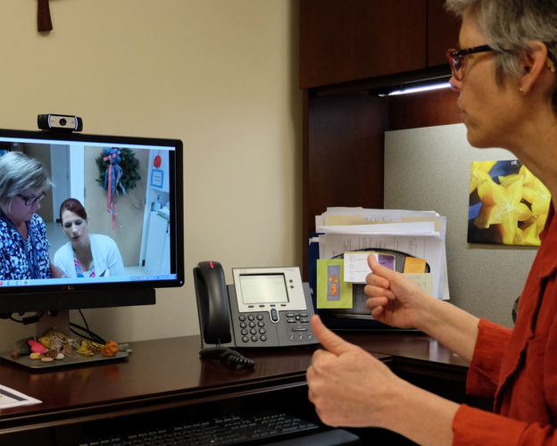
Benefits of CCaaS in Healthcare
Healthcare needs:
Frustration-free interactions
Appointment adherence
Stringent privacy & security
Patient engagement
Solution can help:
Speed transfers, streamline menus, reduce hold times
Deliver reminders at scale
Enable HIPAA compliance
Keep care teams & patients connected
To deliver:
High patient satisfaction & positive provider reviews
Savings in valuable provider time
Secure and efficient patient interactions, including self-serve
Better informed patients and staff
Notes:
We are going to tell you that there is great opportunity not ready overnight but we are here to support you
Go out with the conf we got your back!!

Slide 25

Benefits of CCaaS in Service industry
(restaurant|retail|hospitality)
Service companies need:
Call handling w/o busy signals
Predictive call routing
Distinguish $10 calls from $10k ones
Real-time and historical insights
Solution can help:
Implement call queuing
Dynamically change call routing based on lookups
Get high-value clients to right agents
Provide real-time and historical dashboards & reports
To deliver:
More revenue captured
Efficient issue resolutions
Better retention of high-value customers
Actionable data to help plan now and well into the future
Notes:
Terry slide for commentary!
We are going to tell you that there is great opportunity not ready overnight but we are here to support you
Go out with the conf we got your back!!

Slide 26
Poll Time!
Meeting and exceeding customer expectations, now and into the future…which needs do you anticipate?
(Poll will appear on-screen)
Notes:
Rapid turnaround as circumstances change
Uptime and minimal IT disruption (when changing solutions)
Quickly scale up (or down) to meet unplanned demand
Integration needs (off-shelf or custom)
Some, all, or other

Slide 27

Poll Time!
Q
A

Slide 28

THANK YOU for your time!

